Slide 1
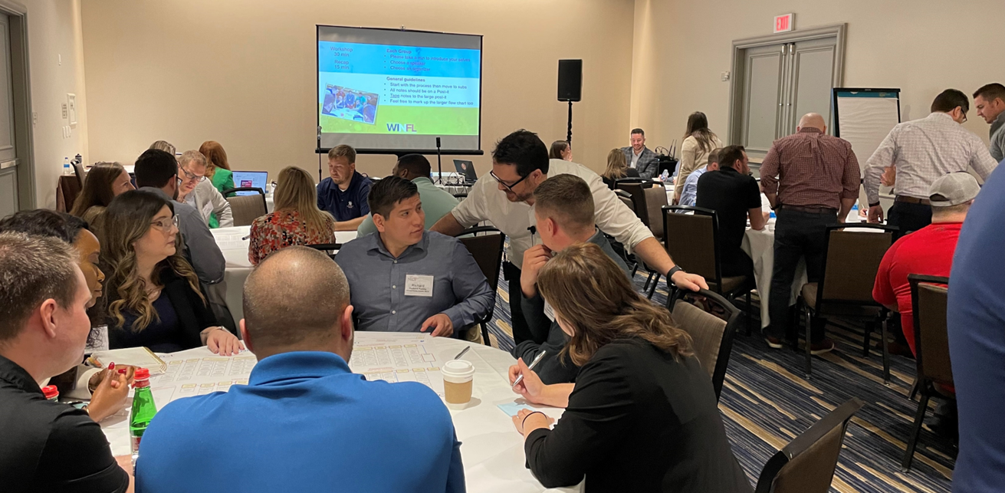
Mapping your Tech Stack a Practical Guide
Jonathan Marsh
CEO SteelToe Consulting LLC
Construction Technologist
Notes:
Trent intro self then ME

Slide 2
Talking Tech
How do you talk tech when you do not know the language?
Think and Talk about new tech as if it is an employee
Ask Questions in human terms
Refer to jobs not features
Use Qualities vs Specifics

Slide 3
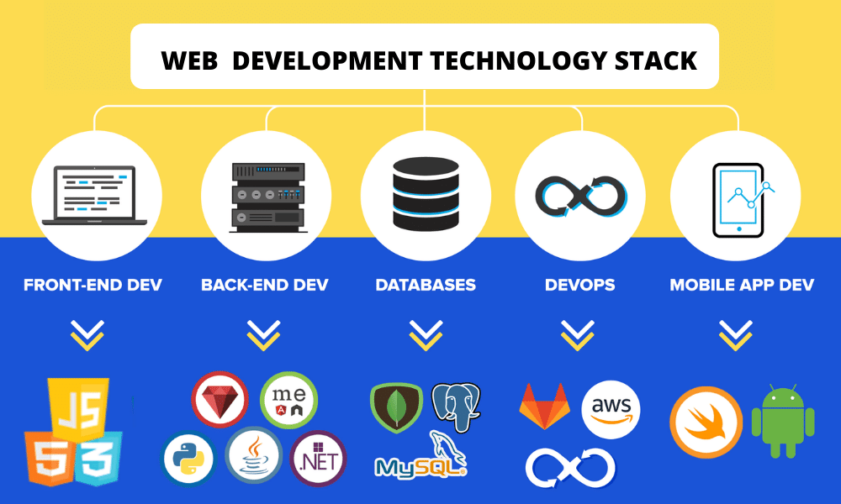
What is a Tech Stack?
The combination of technologies a company uses to build and run an application or project.
“Description of your digital footprint”
Project or application
The Job to be done
The tool for the job
Top Web Development Stacks In 2022: Front-end, Back-end & Database

Slide 4
What is a Tech Stack?
Project or application
Warner Brothers Theater
The Job to be done
BIM
Collaboration
Distribution Mark-up
Content
Capture and layout
The tool for the job

Slide 5
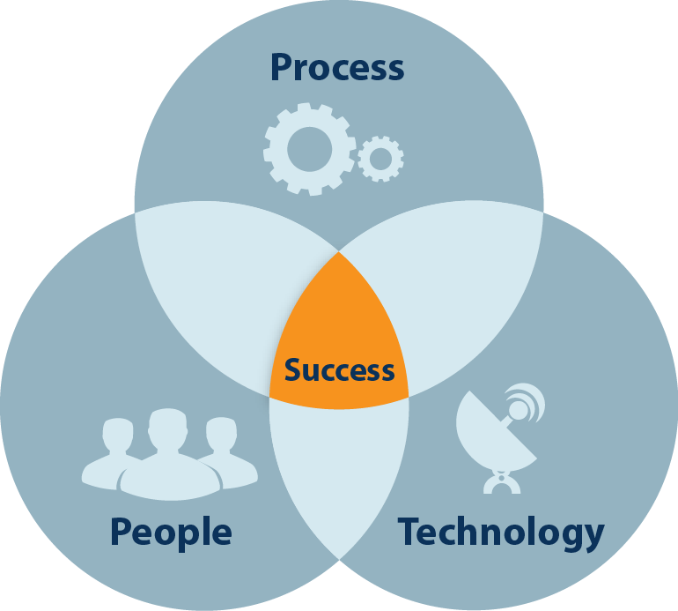
Why Map Out Your Tech?
!!CONTEXT!!
Connect people to technology
At a glance understanding
Collaboration
Measurement & analytics
Consistency
Helps in training and recruitment
Provides direction
Helps avoid redundancy
Helps identify real problems

Slide 6
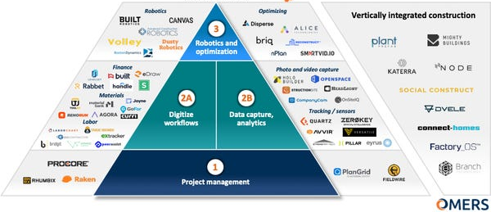
Construction Tech Stack
The tool for the job
The job to be done

Slide 7
What is a Market Map?
The Job to be done
The tools for the job

Slide 8
Other parts of a Tech Stack
Work Group
The Job to be done

Slide 9
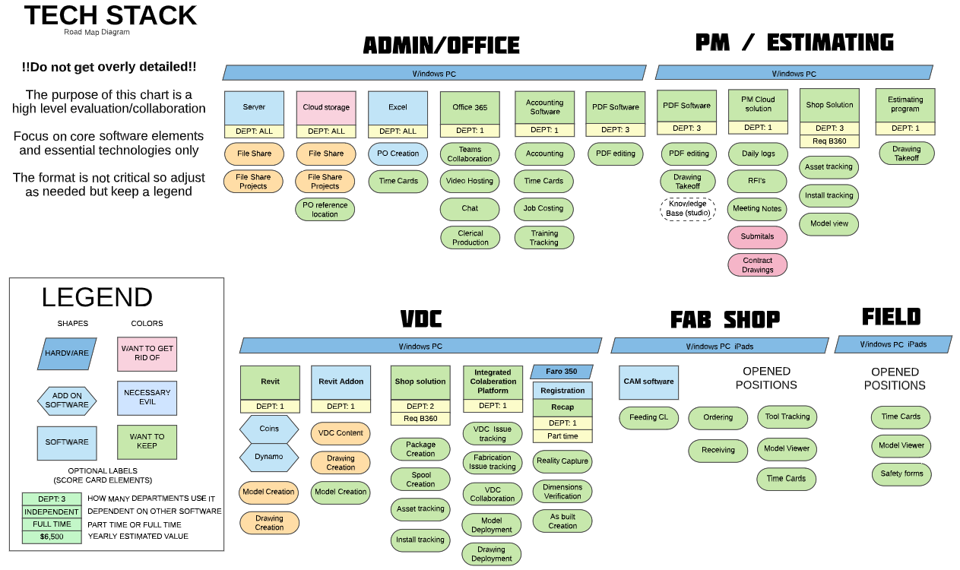
Tech Stack
Work Group
Tool Chest
Tools
Jobs
Jobs With out Tools

Slide 10
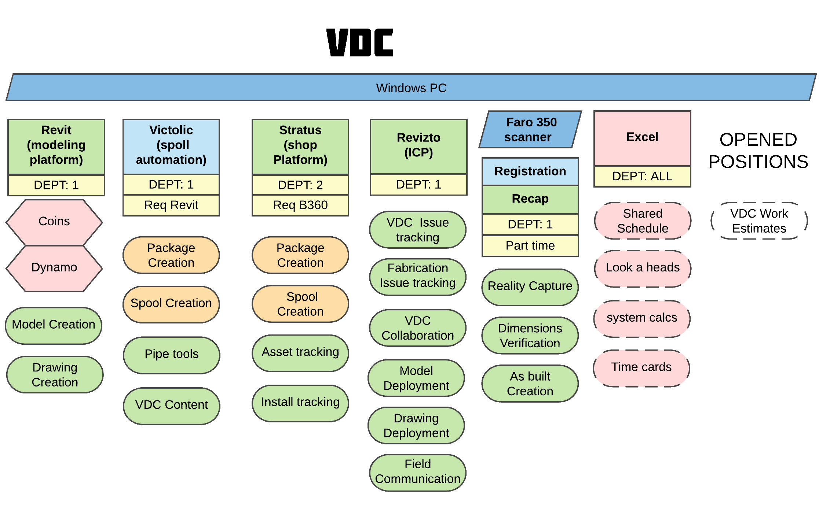
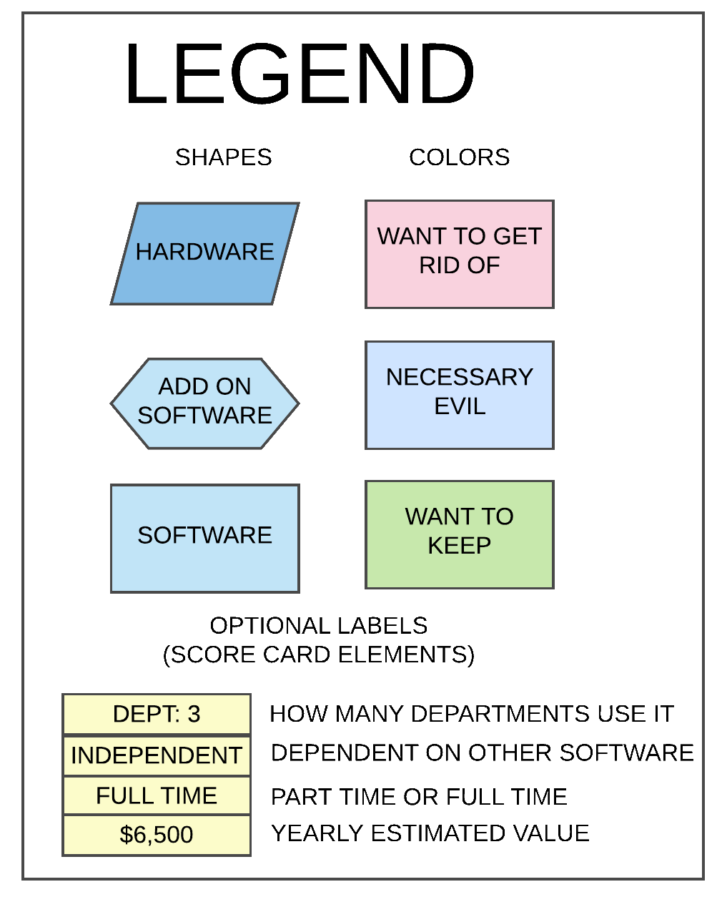
Tech Stack
Tool Chest
Tools

Slide 12
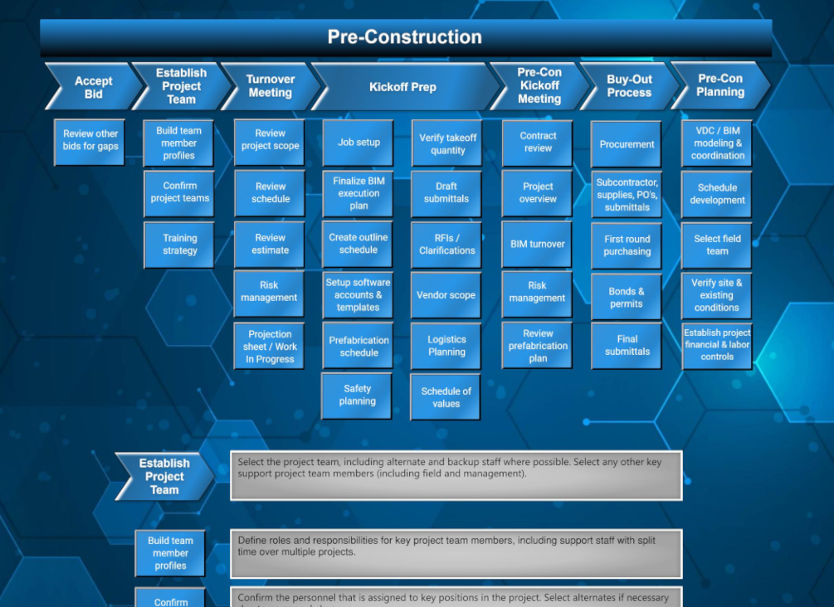
PHASE
PROCESS
SUB-PROCESSES
DESCRIPTIONS

Slide 13
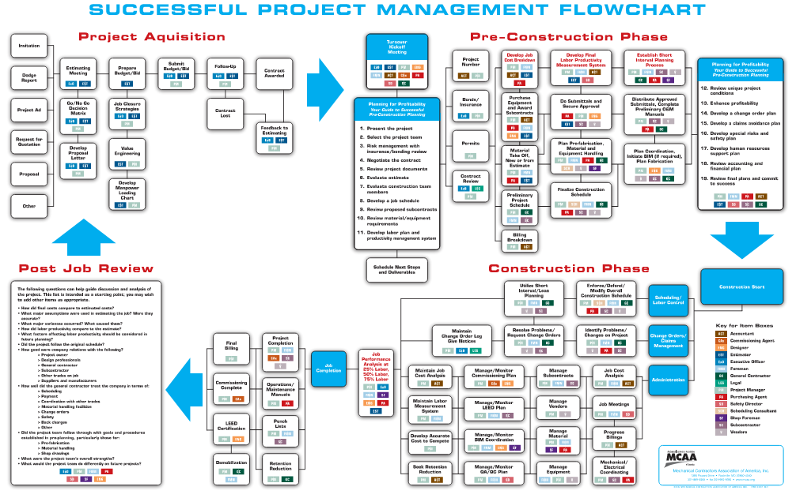
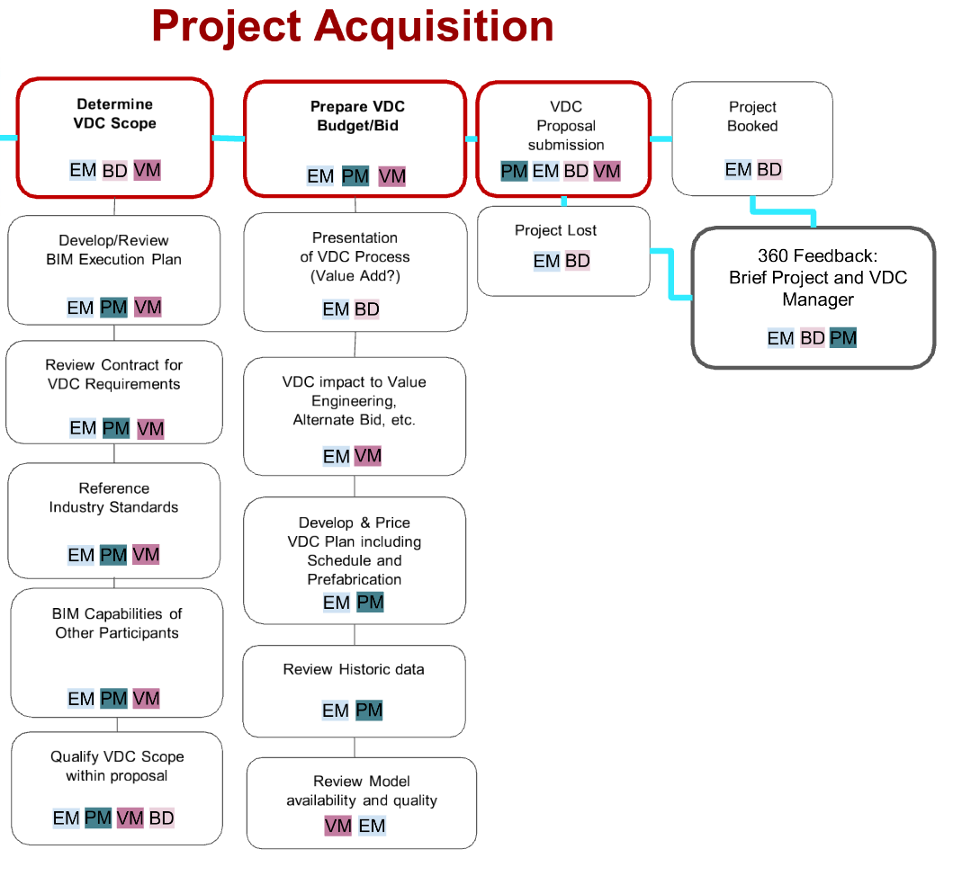
Parts of a Process Map
*PHASE (3-5 WORDS) *PROCESS (3-8 WORDS) *SUB PROCESS (3-12 WORDS)
PHASE
PROCESS
SUB-PROCESSES
The Jobs to be done

Slide 14
Steps to Creation
Determine Scope – Decide what constitutes essential technologies in need of collaboration
Identify Work Groups – Group teams that share similar functions typically departments, but can be task groups
Technology survey – Identify technology assumed to be in use and list relevant information and features
Identify Jobs to be done – List jobs / uses of technology based on survey
Identify potential jobs to be done – List possible or desired jobs / uses of technology based on process review and team requests

Slide 15
Determine Scope
Decide what constitutes essential technologies in need of collaboration
Not all software needs collaborative review.
This diagram should not be sufficient to fully support IT or CT needs without significant secondary documentation.
Anything on that chart should have a clear use. A good rule of thumb is the use should be decriable in a sentence or two.
Limiting the amount of space that the diagram can take up will help drive priority thinking.
Additional linked information and appendices should be used for detailed information where necessary.
Project specific Tech Stacks are often very useful and can be a great way to maintain clarity without over complicating an organizational tech stack.
This should not be a wish list or an organizational chart.

Slide 16
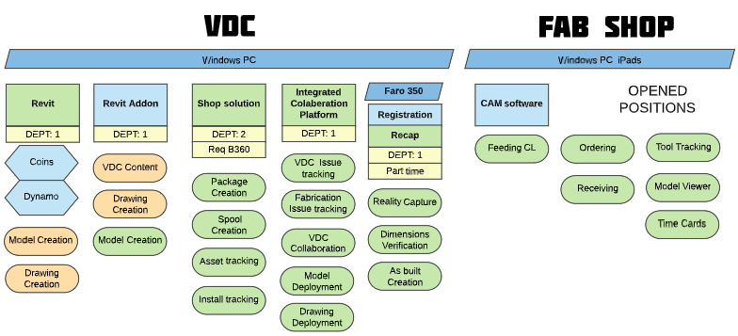
Identify Work Groups
Group teams that share similar functions typically departments, but can be task groups
Not all members of a group need to use the software
Where possible match prosses groupings
Groups should be easily identifiable to team members
This is not an org chart!!!

Slide 17
Technology Survey
Identify technology assumed to be in use and list relevant information and features
Name of application or hardware and provider
Uses/jobs that software preforms
Groups impacted / number of users
Software dependencies and dependents
Interrelationships with other technology
Costs - Purchase, maintenance, and subscription and renewal schedule
Hardware required
**Add more over time not everything needs shown in the diagram**

Slide 18
Identify Jobs to be done
List jobs / uses of technology based on survey
Should be 3-6 words
Should be general terminology
Be consistent between Work groups
Color code duplicates
Link to higher level of detail if required
Avoid wish list items (or color them)
Avoid general office, incidental or obvious entries or create IT Silo
** Too many details can diminish the usefulness and longevity of the diagram**

Slide 19
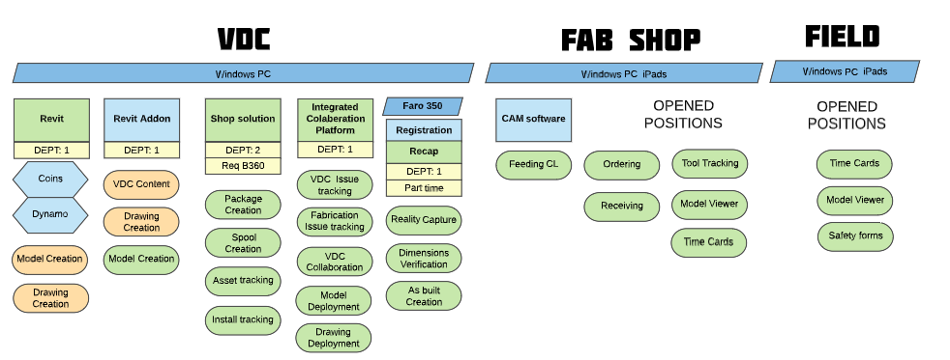
Identify potential jobs to be done
List possible or desired jobs / uses of technology based on process review and team requests

Slide 20
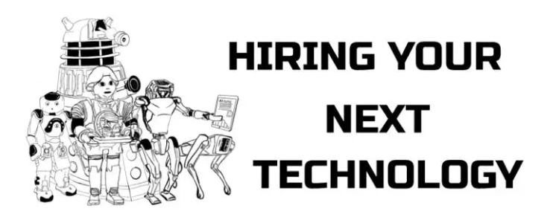
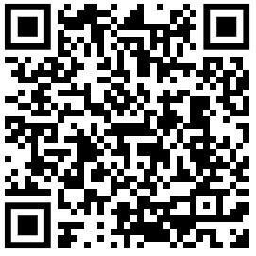
Language Matters
Technology can be more easily understood by none technical staff when talked about using human attributes. The same questions we use to evaluate people will almost always apply to technology too. (Anthropomorphic language)
Full-Time vs Part-Time
Experience Level
Talent
Cultural Fit
Retirement
Insubordinate
Honeymoon period
A pain to work with
Moon lighting
Wastes time with others
Wants too much money
Overqualified
Attractive but not good at their job

